Slide 1
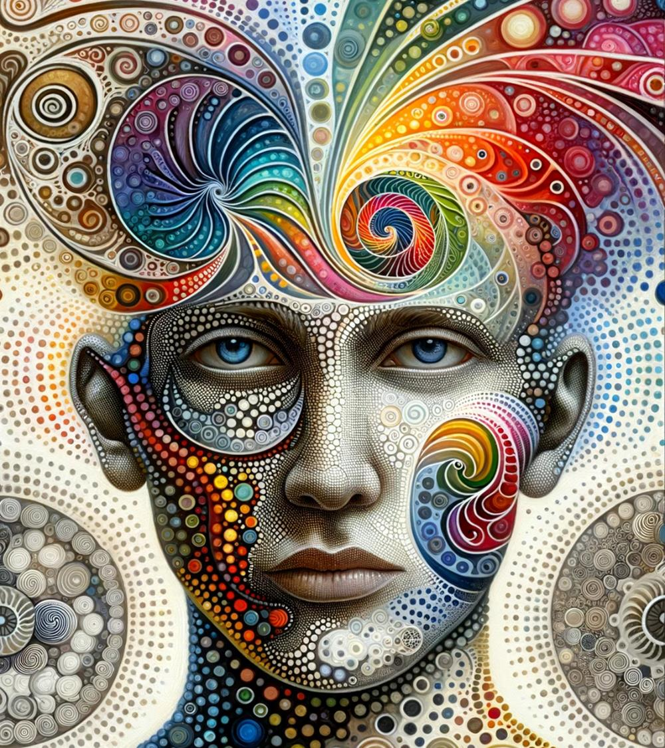
Fragrance
Trend Book
2025

Slide 2
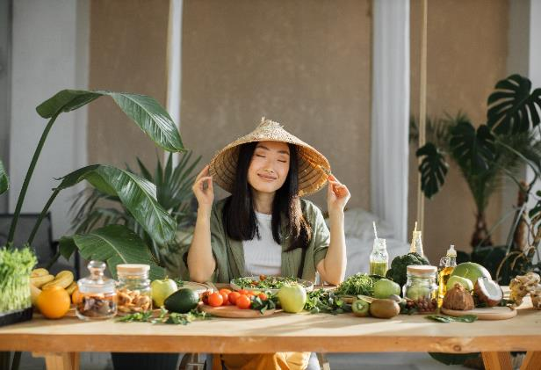

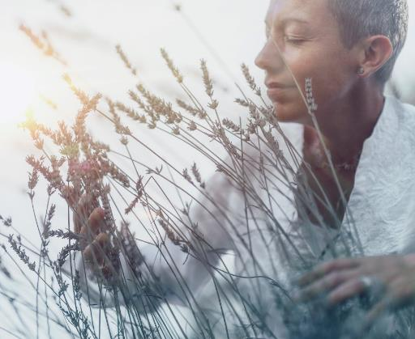
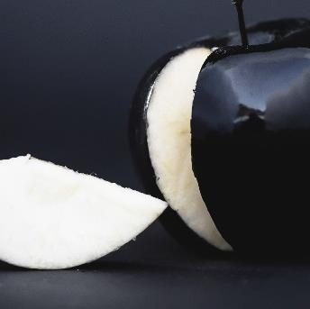
Our marketing experts and creative developers benefit from an environment that welcomes constant exchange and close collaboration. The discovery of new ideas and their translation into marketable products is supported by an inspiring set-up of tools:
Trends
With a constant eye on the latest trends in lifestyle, interior, design, fashion, beauty and perfumery, we develop concepts that inspire. We create fragrances that not only reflect the spirit of the times, but also show perspectives for future market developments.
explore
your
senses
Desktop
Research
Store
Checks
Trend
Agencies
Hamburg
Metropolitan
Region
Cross
Category
Exchange
Newsletters

Slide 3

Fragrance
Trends 2025

Slide 4

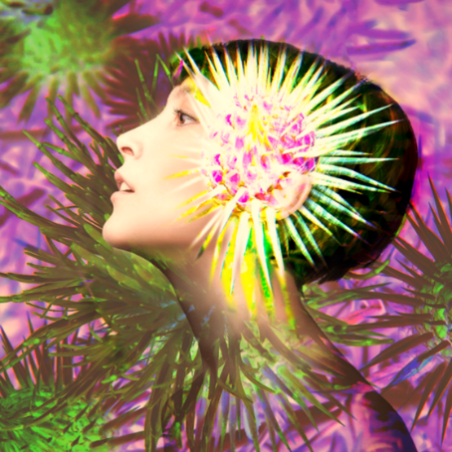
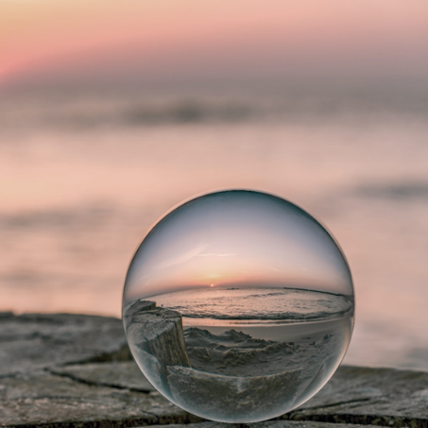




Fragrance Trends 2025
CONTENT
DEFINITION
COLOUR CODES
KEY WORDS
ELEMENTS & MOOD
INGREDIENT INSPIRATION
FRAGRANCE COLLECTION

Slide 5
Fragrance Trends 2025
CONTENT
DEFINITION
COLOUR CODES
KEY WORDS
ELEMENTS & MOOD
INGREDIENT INSPIRATION
FRAGRANCE COLLECTION

Slide 6
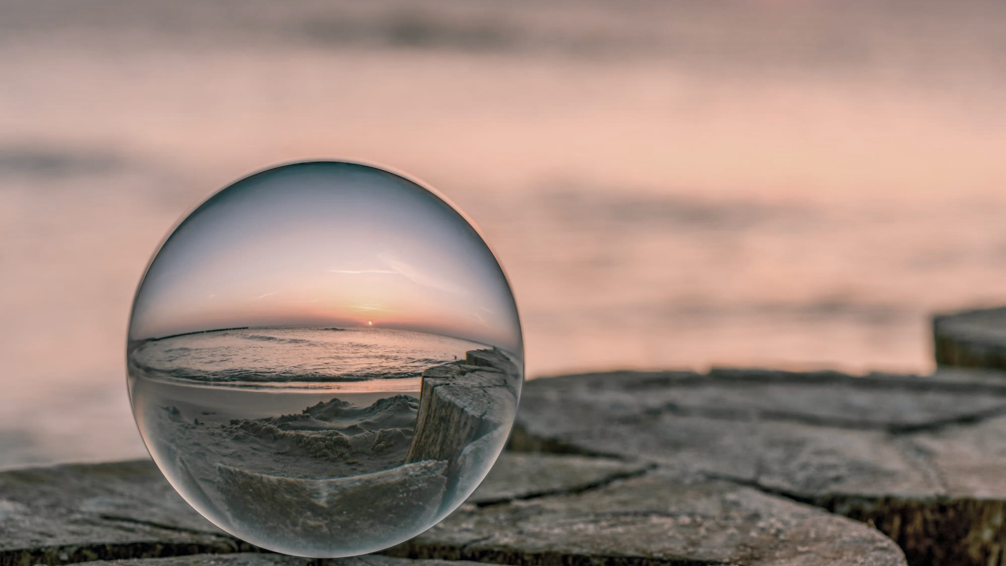
HA EN
true
V
In the noise of our times, full of uncertainty and fast-moving changes, we find a place of refuge that allows us to rest, ground and comfort ourselves.
The honest simplicity of everything
around us allows us to slow down,
gives peace and clarity.

Slide 7
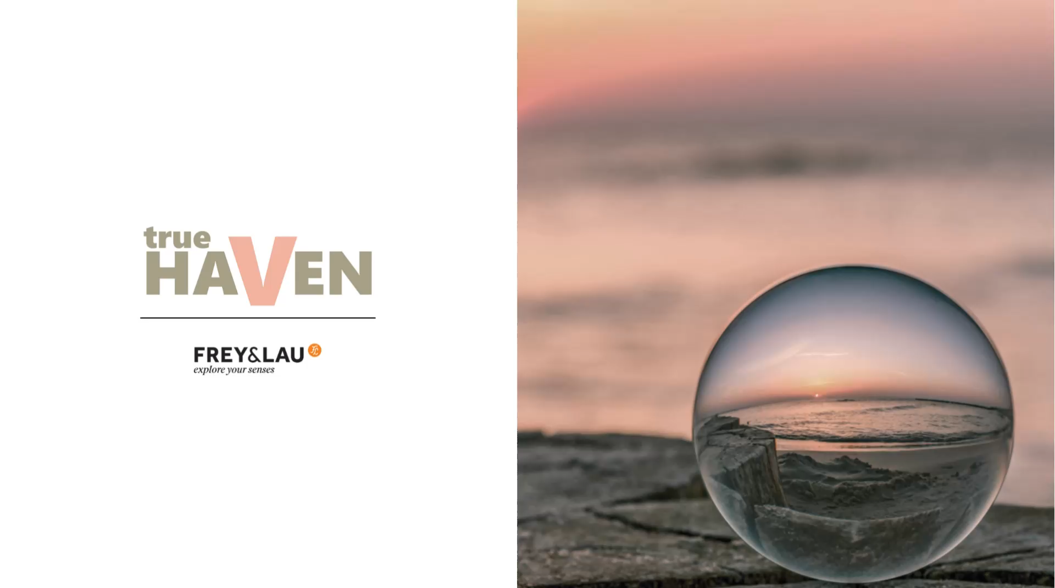

Slide 8


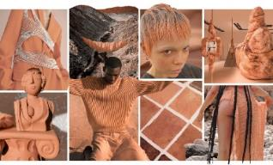

Clear
Conscious
Stable
Honest
Calming
Comforting
KEYWORDS
Monochrome
COLOUR
CODES
Re-assuring
Healing
Fragrance Trends 2025
Optimistic
Sophisticated
Reliable
Conscious consumers who are feeling uncertain turn to practical and reliable neutrals with tried and true hues. Unfiltered Neutrals are colors that reflect a pursuit of balance, serenity and regeneration.
A softer and more sophisticated version of black
Greys ares solid and reliable
Browns evoke stability and imply sustainability
ANCHOR
COLOR
2025
Terracotta is a vitamin infused, nurturing coral that encapsulates the benefits of sunlight and feelings of gratitude!
Notes:
[Anchor Colors are the emotional drivers that will captivate consumers and drive newness for future assortments. These colors are incredibly versatile and relevant to all markets. They can be combined as a duo with any other color in the New-Haven trend color range 2025.]

Slide 9


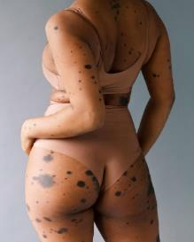
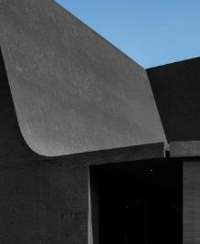
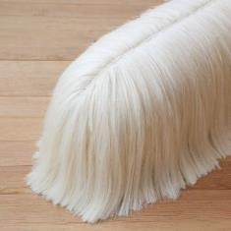
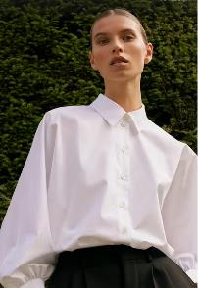
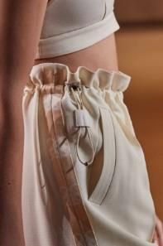
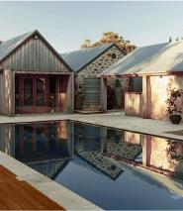
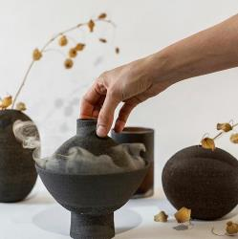
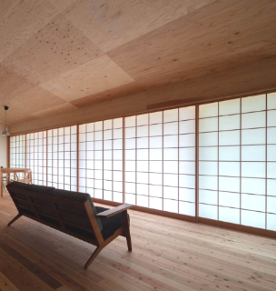
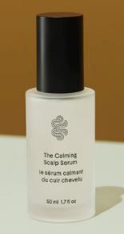
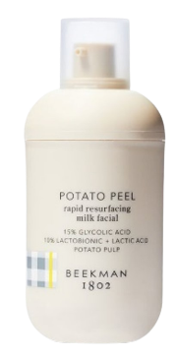
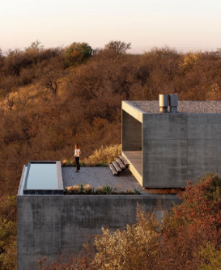
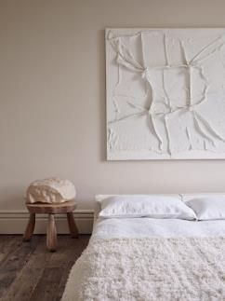
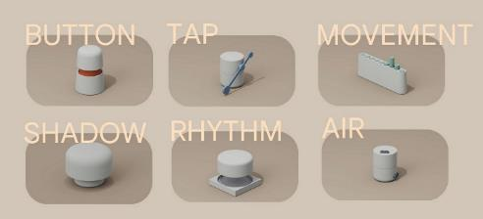
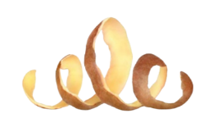
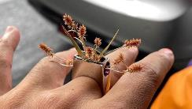
HA EN
true
V
Airy & Lightweight
ELEMENTS &
MOOD
Fragrance Trends 2025
FASHION
Feel Good Jerseys
Clear lines with
soft curves
BEAUTY
Quiet Luxury
Sensual Tactility
Natural SPAs
Relaxation
Corners
RITUALS
& SPACES
Natural + Untreated
Textural monochrome surfaces
Romanticized
Utility
Simple
Protective
Serums
Uncluttered Spaces
Basic
active
ingredients
INTERIOR
& DESIGN
Hide-Aways:
Modern architecture in natural settings
Calm Technologies
Mindful
Wearables
Notes:
A TREND CONCEPT THAT CELEBRATES THE BEAUTY AND POWER OF MINIMALISM. SIMPLICITY COINCIDES WITH DECENT LUXURY AND SMALL DAILY DOSAGES OF MINDFULNESS.
BEAUTY
… celebrates protective and simple routines that restore, protect and accept the skin we are in.
Natural & Untreated
The movement towards more diversity is changing the way we look at beauty: individuality is desirable and supposed flaws are special - especially interesting! Brands that recognise this are valued beauty partners of "True Haven" consumers
Sensitive solutions with weightless textures that provide soothing + smoothing.
Example: Calming Scalp Serum from Crown Affair (US/$58)
- Restores the skin’s barrier to protect, to balance and deliver instant soothing comfort
- Mild, gentle and lightweight
- Easy hair care ritual, even on the go
- Key ingredients: Aloe Vera, Tea Tree, Hyaluronic Acid
Traditional and basic active ingredients eg:
Example: Potato Peel Rapid Resurfacing Milk Facial ($49) from Beekman 1802:
- gentle facial peel clinically proven to smooth skin texture, minimize dark spots & reveal youthful skin
- potato is a natural source of hyaluronic acid which is an excellent agent to replenish skin moisture and hydrate your skin from within
- Beekman 1802 is made for sensitive skin (and sensitive people). Effective clean formulations that work with your skin, not against it.
- Beekman: there is beauty in kindness!
INTERIOR & DESIGN
…offer a mindful reset where our wellbeing is at the core!
Clean lines, essential elements and uncluttered spaces provide a sense of serenity, allowing the eye to focus on few carefully curated objects of refined craftmanship.
Gentle curves and carefully applied tone-in-tone textures provide visual interest without stimulating a sensory overload.
Small doses of softer materials invite to touch and experience tender tactility.
Example: Stool from Mexican designer Fernando Laposse (London) featured at “Art Community Frankfurt” as part of exhibiton 2023/2024. Laposse is using agave fibre here to set traditional agricultural materials in a new context.
FASHION
Fatigue around the fast change of aesthetics and our noisy trend culture is manifesting in a desire for timeless staples that last and for a more quiet form of luxury.
Example: “Quiet Luxury“ featured in Magazine „Harpers Bazar“ in 2023 (picture: blouse from Seidensticker)
"Quiet Luxury is the aesthetic of secret wealth. Neutral colours, simple silhouettes whose sophistication is only in the details. Status is not signalled with a logo or monogram, but subtly with the highest quality, flawless workmanship and exquisite materials.“
Feel-Good-Clothing, comfy materials and utility fits are a basic need.
A fallback to traditional values might be assured by nostalgic and romantic details which are carefully placed.
RITUALS & SPACES
…provide a minimal yet inviting retreat from the daily stressors of life.
Relaxation Corners
…in our home remind us to relax and to let our spirit take a pause from time to time to enjoy conscious me-time. Fostering mindfulness and self-care.
Calm Computing
…allows connection with the outer world without noise or vibration. More subtle solutions to manage notifications without acoustic warnings or vibrations.
Example: Google Calm Technology “Little Signals” (in development)
six objects:
Button: the upper part rotates and is push down, like a button, at a smooth rhythm.
Tap: small knocking sounds are created
Movement: seven small cylinders that rise and fall rhythmically
Shadow: generates small shadows around the object
Rhythm: This gadget works like a wave, separating the upper part from the lower part.
Air: emits a current of air to attract attention. Place it, for example, next to a plant and when you see its leaves move, you will know that a notification is coming.
Mindful wearables
…represent small encouragements and little cheer-ups to face difficult moments which challenge us to master stress. Everpresent affirmations for mental strength and small doses of happiness.
Hide-Aways
…offer a new form of luxury: very reduced contemporary architecture in natural idyllic settings allows to disconnect from the world and to connect with nature and ourselves

Slide 10
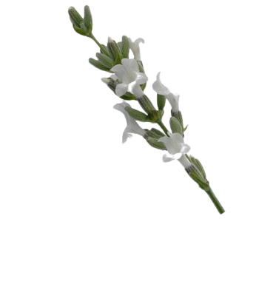
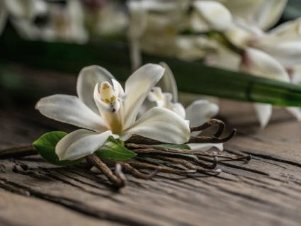
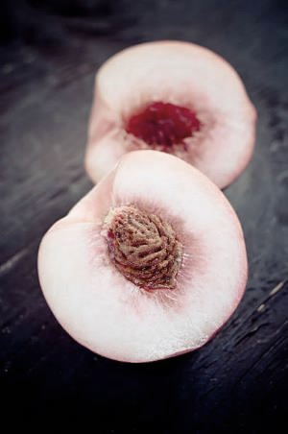
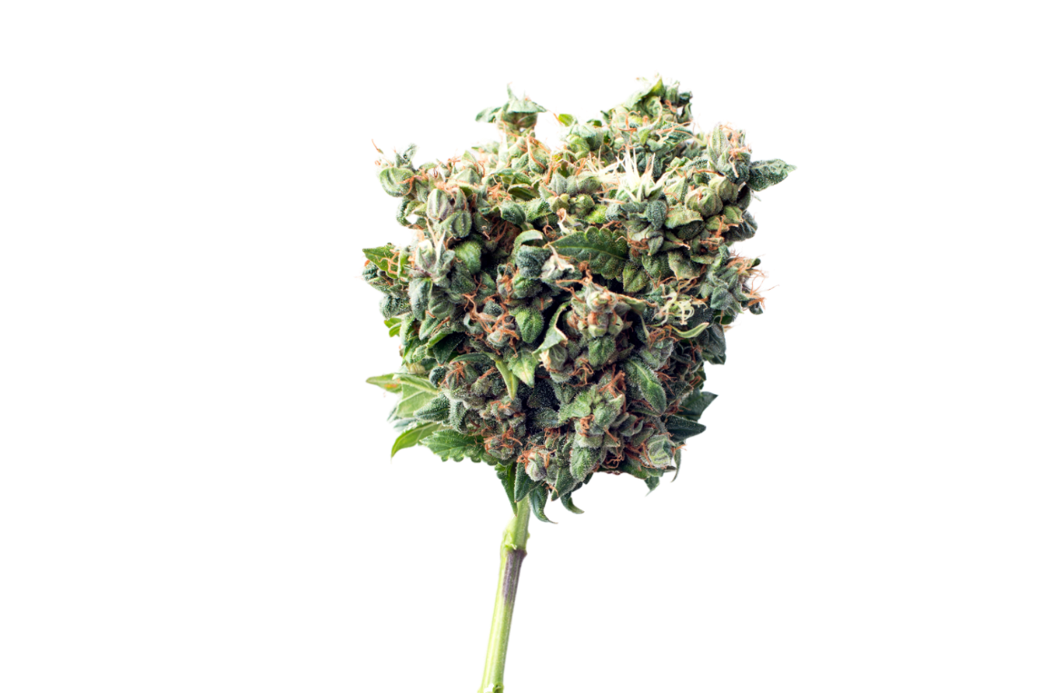
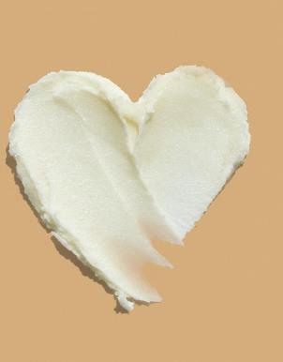
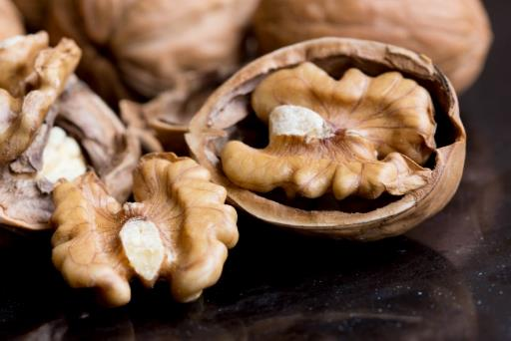
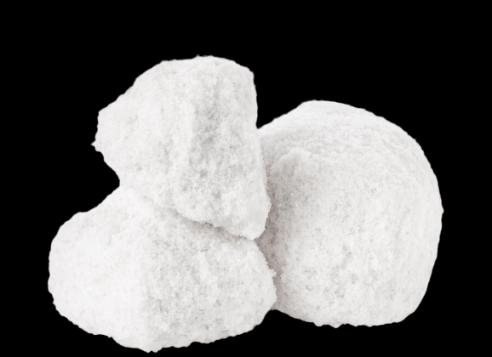
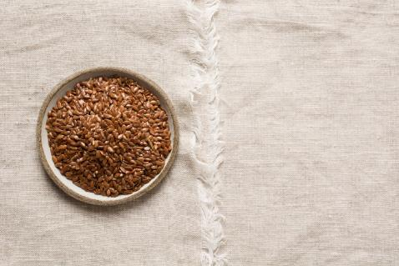
HA EN
true
V
INGREDIENT
INSPIRATION
Fragrance Trends 2025
Vanilla
LIGHT
White Peach
White Lavender
Sheabutter
WARM
SOOTHING
FRESH
CLEAN
White Lemon Cannabis
SOLID
HEALING
Walnut
PROVEN
Sea Foam
Linen + Linenseed
Notes:
Nothing charging!
White versions of proven/successful ingredients communicate more calm, cleanliness and lightness:
White Peach
White Lavender
White Lemon Cannabis:
It is known for its energizing and uplifting effects. It may be useful for those seeking relief from stress, anxiety, or depression. In terms of taste and aroma, White Lemon is known for its lemony and fruity notes with hints of earth and spice. Its aroma is mild and pleasant, making it a popular choice for those who prefer a less spicy variety (of cannabis).
Cannabis in skin care:
CBD (cannabidiol) reduces the reactivity of skin cells by telling them how to calm themselves. This helps against redness, rough skin and a dull complexion.White Lavender & White Peach:White versions of proven/successful ingredients communicate more calm, cleanliness and lightness
Sea Foam:
In ancient times, sea foam was used for gentle face and body cleansing. The extract of sea foam is very high in magnesium, an anti-stress mineral, and rich in silicon, the beauty mineral. It remineralizes and strengthens the skin and provides a clear and refreshed complexion.
Associates easiness, refreshment and cleanliness (supports everlasting trend of ocean concepts).
A nice ingredient blend for “True Haven” is the combination of these white or lighter ingredients with those that we perceive as warm and solid (e.g. vanilla and walnut) or with tried and tested “home remedies” such as linen and linseed (vintage trend).
Creamy, soft fruit butter (e.g. shea butter) complements the product formulation with pampering and soothing care.

Slide 11

HA EN
true
V
Premium Fragrances
Nude Honesty
P0242519
Quiet Luxury
P0228760
Natural Fragrances
Tender Reset
P0252632
Competitive Fragrances
Mindful
Retreat
P0273624
True
Essence
P0273626

Slide 12
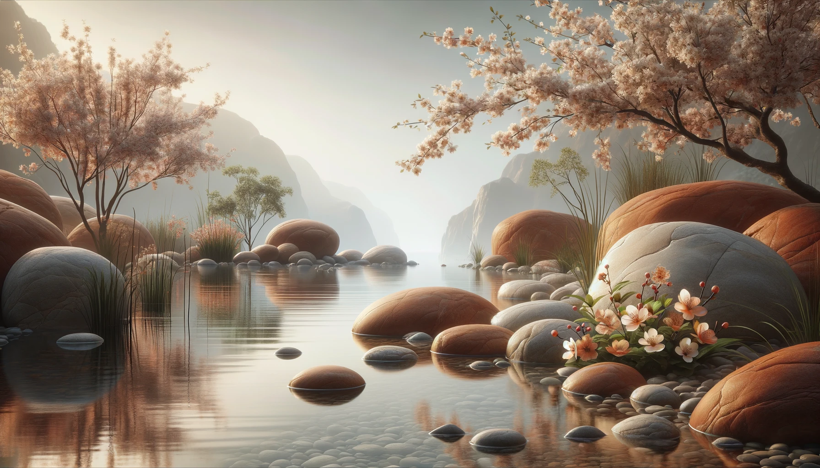
Premium Fragrance
Nude Honesty
P0242519
Nude Honesty enchants with a fresh melody of lemon, bergamot and a hint of eucalyptus. Floral notes of lavender and peach blossom combine with the warmth of vanilla and sandalwood to create a perfume oil that captures naturalness
and subtle seduction in every drop.
fresh
Lemon
TOP
Orange
Bergamot
Eucalyptus
herbal
Lavender
HEART
Thyme
Peach
Mint
Ylang-Ylang
Peach Blossom
Nut
Sandalwood
BASE
Vanilla
Amber
Cream
Caramel
Musk

Slide 13
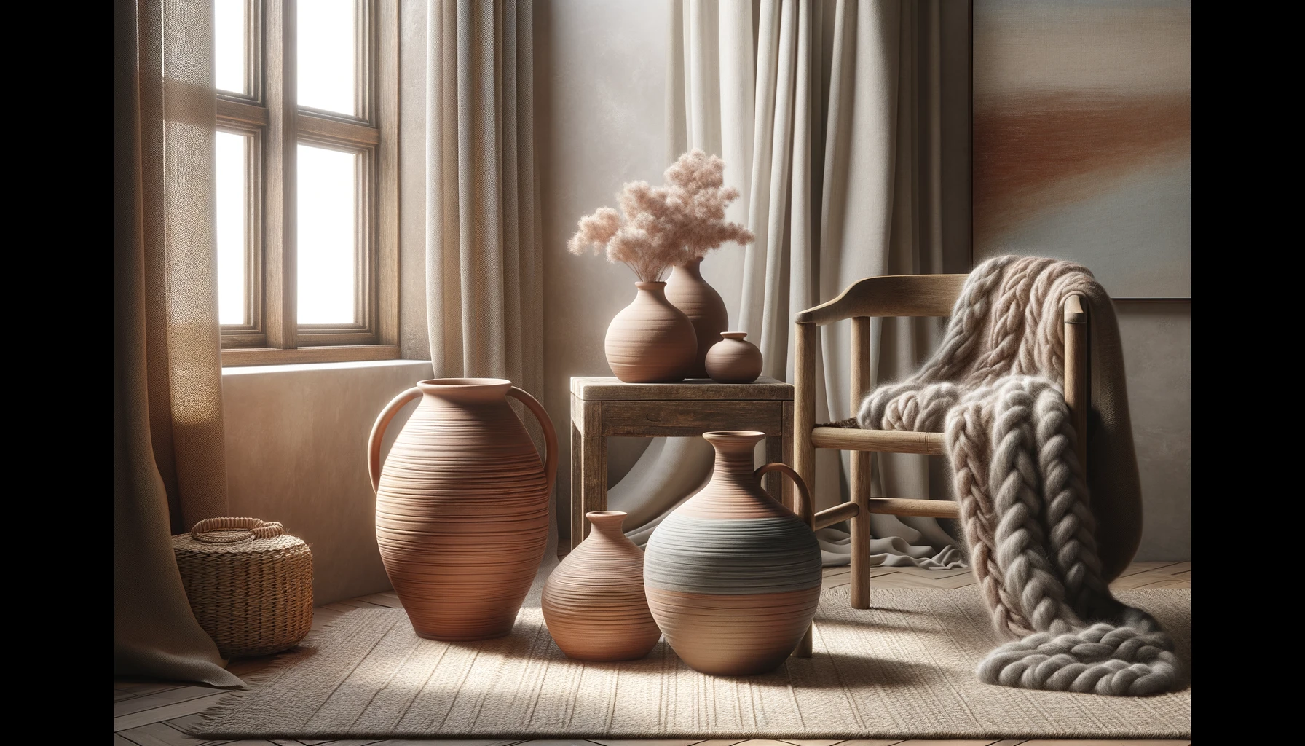
Premium Fragrance
Quiet Luxury
P0228760
Quiet Luxury combines fresh notes of lemon with aquatic lightness. Floral accents of lily of the valley and rose blend with sandalwood and vanilla to create a fragrance that expresses tranquillity and subtle elegance in every nuance.
fresh
Lemon
TOP
green
aquatic
agrumic
floral
Rose
HEART
Magnolia
Violet
Lily of the Valley
Sandalwood
Vanilla
Moss
BASE
Timberwood
Amber
Caramel

Slide 14

Natural Fragrance
Tender Reset
P0252632
Tender Rest blends invigorating orange and lemongrass with calming lavender and delicate peach blossom. Spicy notes of ylang ylang and a warm base of sandalwood and musk round off this fragrance that epitomises calm and serenity.
fresh
TOP
Orange
Howood
Lemongras
Lavender
Ylang Ylang
Nut
HEART
spicy
floral
fruity
Peach Blossom
Sandalwood
Musk
Vanilla
BASE
Guajakwood
balsamic
Cedarwood

Slide 15

Competitive Fragrance
Mindful Retreat
P0273624
Mindful Retreat opens with fresh bergamot and lemon with a hint of coconut. Heart notes of rose and jasmine meet a warm base of sandalwood and musk, which together create
an atmosphere of calm.
Rose
TOP
Ginger
agrumic
Coconut
Bergamot
Ylang-Ylang
Violet
HEART
floral
Jasmine
Lily of the Valley
balsamic
Musk
Sandalwood
Vanilla
BASE
Cedarwood
Patchouli
Tonka

Slide 16
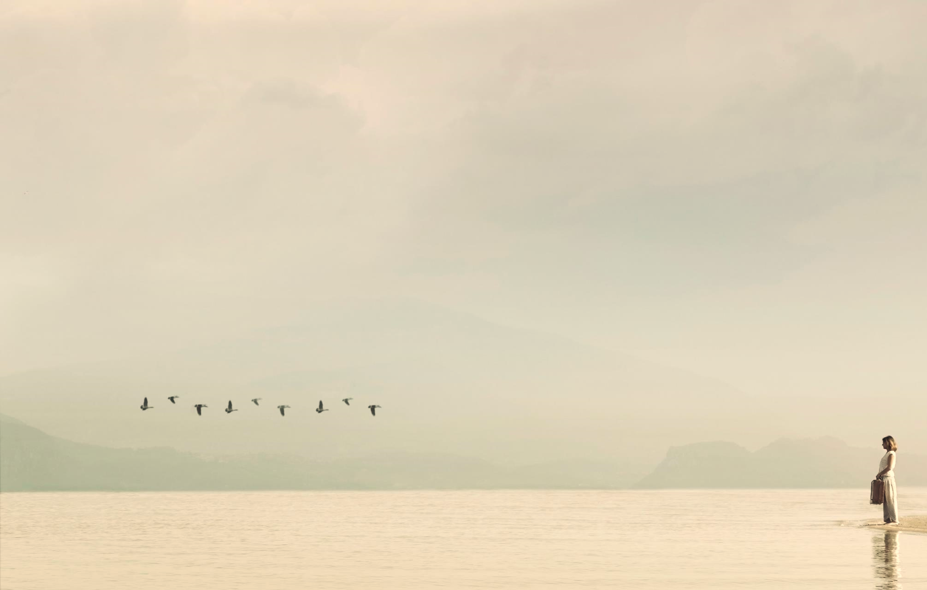
Competitive Fragrance
True Essence
P0273626
green
True Essence pairs vibrant notes of lemon and orange with a floral, spicy heart of lavender, rose and geranium. A base of sandalwood and vanilla gives the fragrance depth and warmth, perfect for moments of mindfulness.
agrumic
TOP
Orange
Lemon
Eucalyptus
Bergamot
floral
Rosemary
spicy
Apple
Lily of the Valley
HEART
Lavender
Geranium
Rose
Tarragon
woody
Amber
Sandalwood
BASE
Vanilla
Timberwood
Moss
Musk

Slide 17
Fragrance Trends 2025
CONTENT
DEFINITION
COLOUR CODES
KEY WORDS
ELEMENTS & MOOD
INGREDIENT INSPIRATION
FRAGRANCE COLLECTION

Slide 18
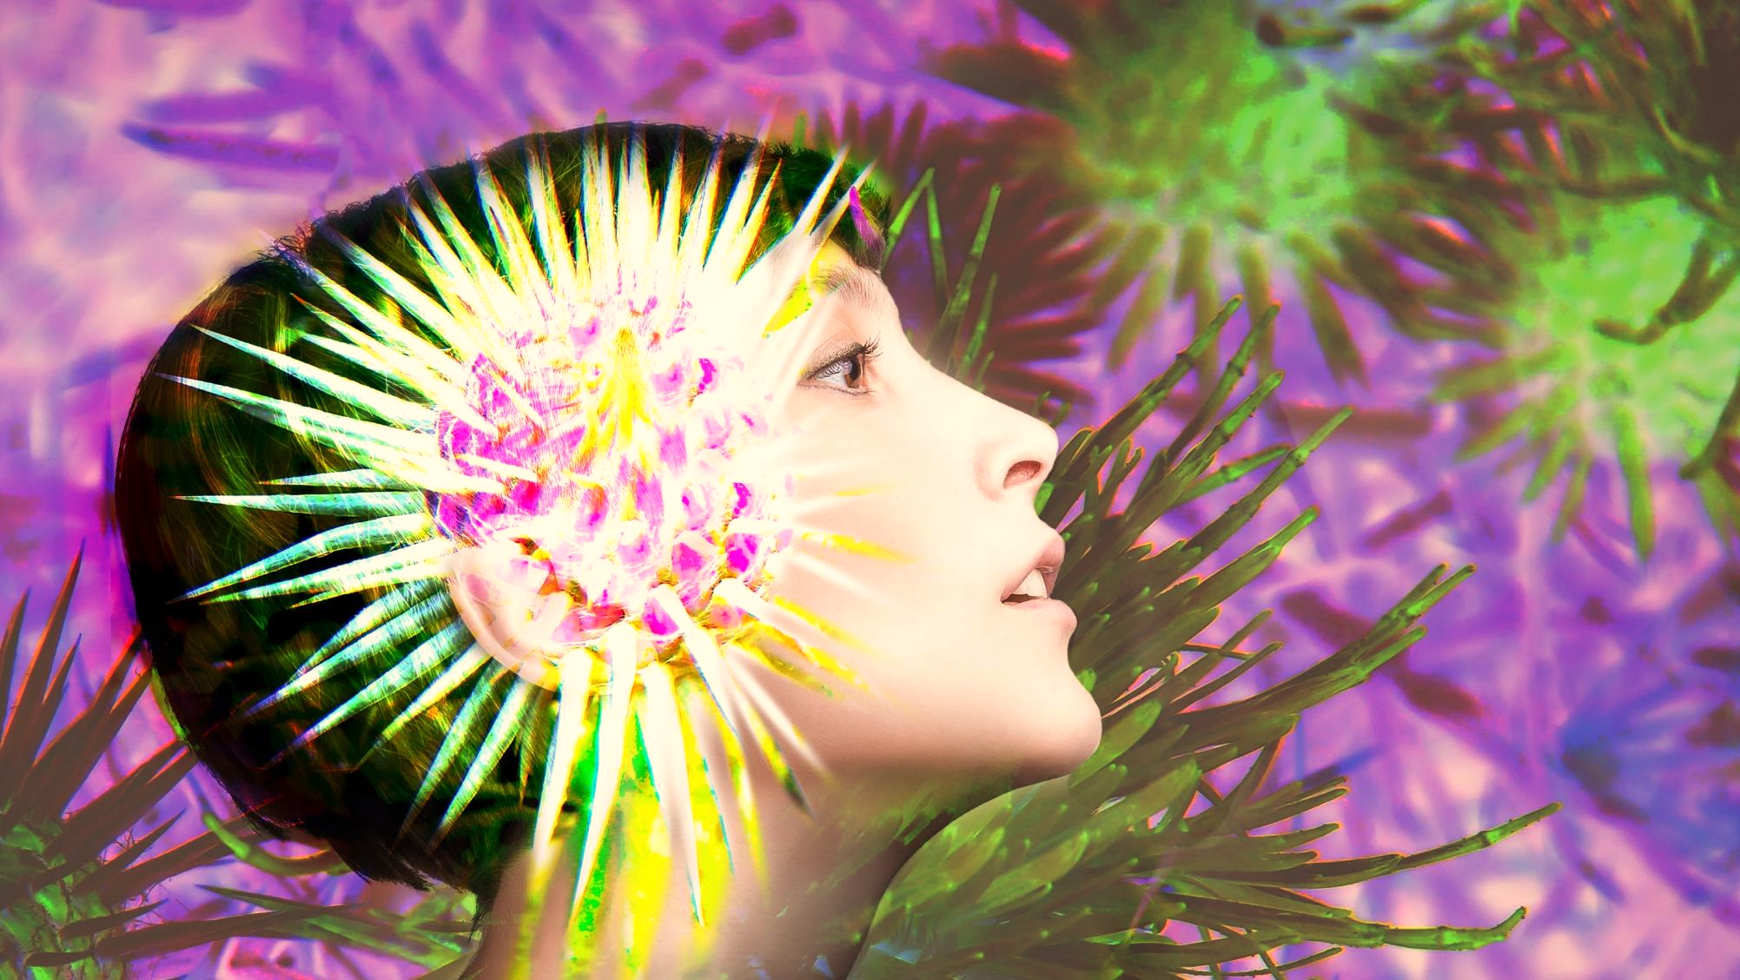
EN GMA
Natural
?
Our intimate connection to nature creates a heightened curiosity about what it still hides from us.
With great openness and AI-inspired creativity, our imagination embarks on an exciting journey of discovery to explore and interpret its unknown spots.

Slide 19
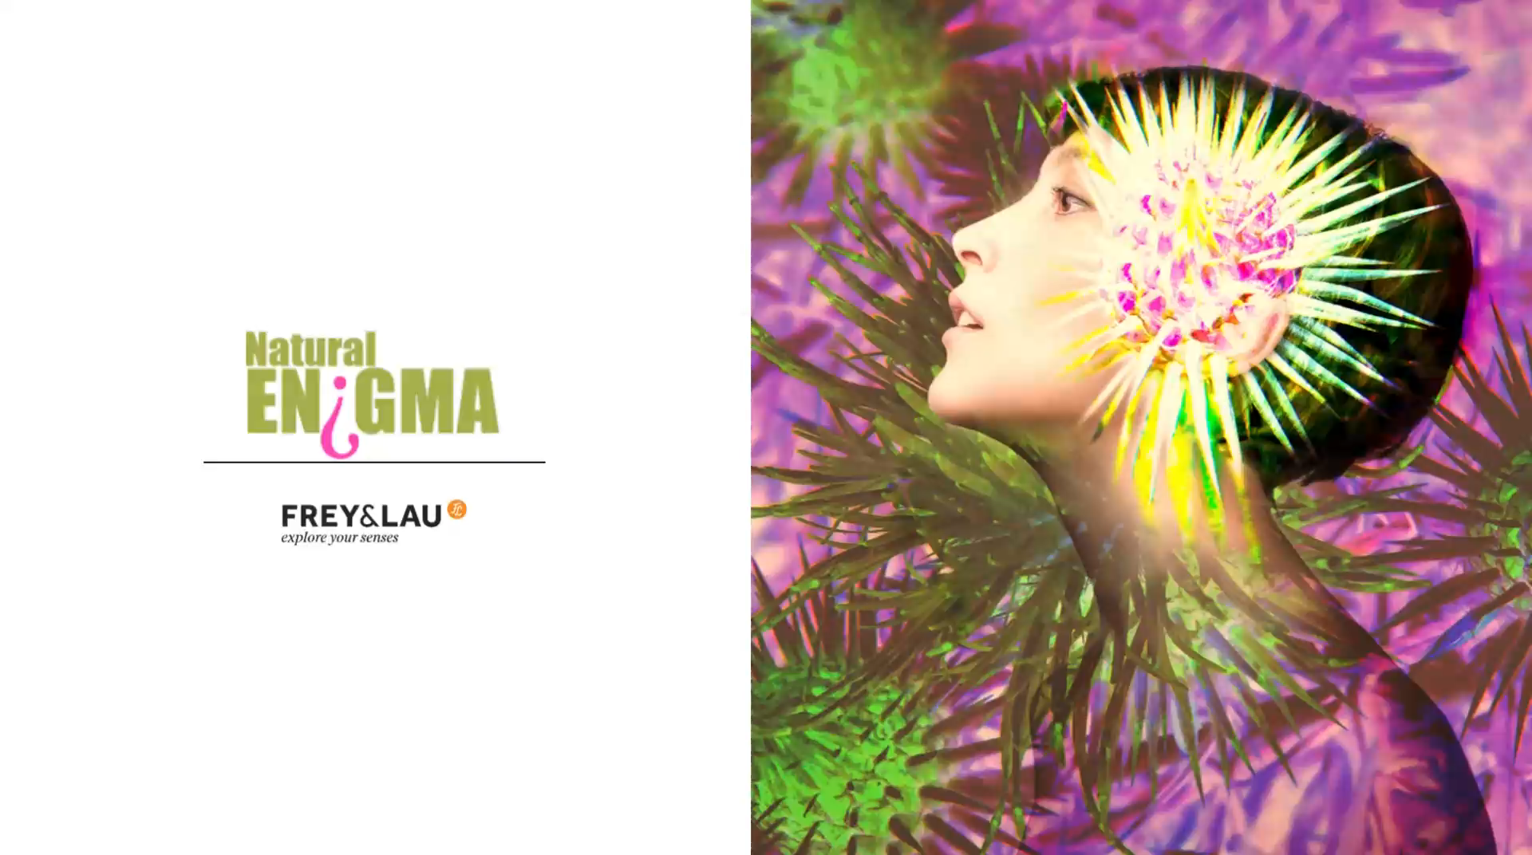

Slide 20
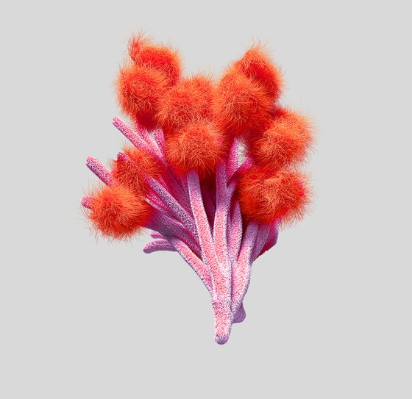
Natural
EN GMA
Morphed
?
KEYWORDS
Flora
AI-Natural
Phenomena
COLOUR
CODES
Vibrant
Fragrance Trends 2025
Bio-Tech
Fantastic
Hyper-Stimulation
Colourful
Creative
A realm between the real and unreal.
Nature is viewed from a fantastical perspective and our world is emotionally charged by wondrous colors.
Mysterious
Fauna
Sensual
purple is balancing danger
Refreshing vitality
from the AI world
Weird…
Intense and impactful
greens – nature as if from a dream
Inviting and dangerous at the same time
A gritty edge
Notes:
Plant (bottom right): Nachei 3D-artist

Slide 21
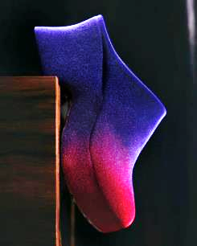
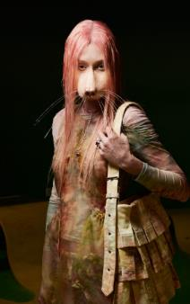
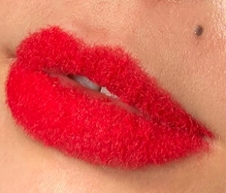
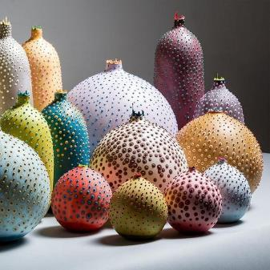
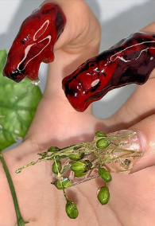
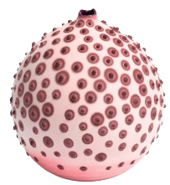
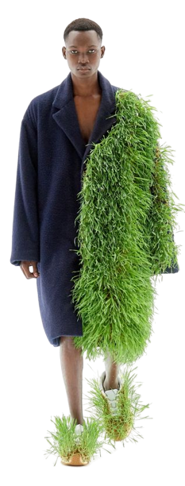
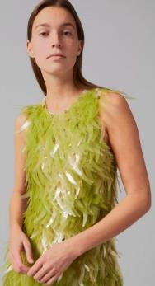
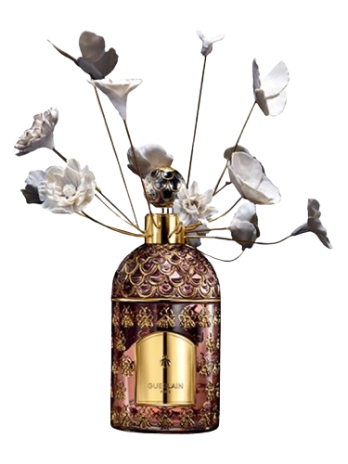
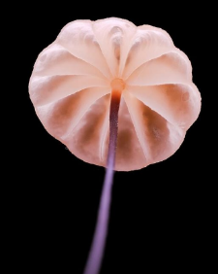
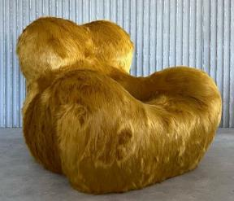
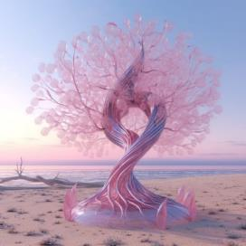




Natural
EN GMA
?
ELEMENTS &
MOOD
Fragrance Trends 2025
FASHION
Alienesque
Morphing
Mimicry
Textural
Macro-Photography
SCENT & BEAUTY
Microbial
RITUALS
& SPACES
Bio-Plastic
Eco-Horror
Gaming + Movies
Inspiration Fauna
Sensual
AI-Art
INTERIOR
& DESIGN
Eco Curiosity –
Natural Museums & Exhibions
Notes:
A design concept that translates the consumer's desire for scientifically explainable natural phenomena and the attraction of fantastic, romantic aspects of the perhaps still undiscovered and unknown into consumer goods. Increased appreciation of the entire fauna (including insects and microorganisms - see "Consumer Needs - Faunatic ") and a new "trendy" thirst for knowledge about natural history and its scientific background (see "Consumer Needs "Eco Science") are increasingly encountered in everyday life and influence design and leisure activities.
The dangers of climate change (see "Emergence of trends - climate change") and the once again heightened realisation that our natural resources are limited are increasing our interest in alternative processes and materials that are natural but do not exploit nature (see "Consumer Needs – Next Gen Nature" and the example of "Bio Plastic" below).
SCENT & BEAUTY
Lips – Kristin Belger:
New make-up look with unconventional textures (looks like moss?)?Hair & Make Up Artist and Instagrammer Berlin. Works for magazines such as Vogue, Blond, brands such as Prada, Chanel and commercials such as Mercedes, Levis.
Valued for her perfect blend of craft, creativity, and passion.
Bee Garden – Guerlain
... the design of the bee bottle celebrated its 170th anniversary in 2023. The "Bee Garden" fragrance to mark the occasion. "A majestic airy garden blossoms around the bottle, as if to lyrically celebrate nature. This remarkable work of art in gold-accented bisque porcelain anchors Guerlain's philosophy as a contribution to the continuity and preservation of biodiversity in matter itself."
The multidisciplinary visual artist Céline Cléron's artistic approach starts with the object, whose meaning or function she modifies in order to add a new dimension to it. Through displacement, connection or hybridisation, familiar images or objects can be used as an impetus for a process of metamorphosis. In her creative process, the living also often enters, so that the animal becomes its own actor in the work. Céline Cléron's sensitive universe and the connection she forges with nature were the starting point for her collaboration with Guerlain.
The top notes are rhubarb and bergamot; the heart notes are neroli, jasmine and rose; the base notes are cedar, black tea and sandalwood.
Sojin Oh (Nails)
…creates otherworldly Nail Art for the Likes of Björk and Hunter Schafer.
For the Los Angeles–based nail artist, inspiration comes from bacteria strains, sea creatures, and chef René Redzepi’s fungi haul.
“The sublime beauty of the natural world influences me to be adventurous. A lot of my nail art is an idealized representation of nature.”
INTERIOR & DESIGN
Vases (Microbial) – Elyse Graham:
“Our Microbe Collection is inspired by the unique galaxy of microorganisms living within each of us. We created a technique for dying and stippling each vase that evokes the nature of microbes as they grow and colonize.”
Armchair (Gaetano Pesce):
“What I try to do with my work is to provoke people to discover what makes them alive,” Pesce said. “In a moment when the world is full of problems (Referernce “Emergence of Trends – World of Uncertainty”), it is good to show that something is positive and optimistic […]. My work is not serious, it makes people happy.”
AI-Art - Gal Tzubary (AI Artist)
Just one example of visual artists whose work is inspired/generated by AI. Fantastic natural worlds satisfy our desire for discovery (at a safe distance), invite us to "dream away" and allow a positive outlook on the discoveries of the as yet unexplored in the future.
FASHION
The Collina Strada Fall/Winter 23/24 runway show
… featured models gliding down the runway in realistic animal prosthetics. Focused on the playful and the fantastical while being wearable, the collection featured lush biodegradable Eco satins and fur-printed pieces.
Loewe (Shoe + Man with grass coate):
The process of natural metamorphosis translated to textiles
Bio Plastic - Algae sequin dress by Phillip Lim and Charlotte McCurdy
Petroleum-free dress covered in bioplastic sequins.
McCurdy created the sequins by binding algae together using heat and placing it in a custom mould to cure and solidify. The bioplastic was cast into sheets and then cut out into tusk-shaped sequins, which were used to cover an A-line dress designed by Lim.
RITUALS & SPACES
Natural History Museums & Ausstellungen
Here: London Museum of Natural History
Makro-Photography (mushroom – Eric chou):
Photographer content creator with a social media marketing and data science background.
Influencer.
Collection of mushroom shoots, making their beauty visible.
Eco-Horror Gaming + Movies
“Climate crisis fuels new wave of TV ‘eco thrillers’” The guardian Feb23
“A new genre is emerging — the environmental action film, or eco-thriller — that addresses the conundrum of climate anxiety by applying the tropes of a heist flick to the mission of curbing the consumption of earth’s resources. Such works bring us to the edge of our seats, making us wonder: Can these people succeed in securing our future? And then, perhaps, can we?
Fighting the apocalypse is a timeworn movie trope. But in an era of environmental catastrophe, some filmmakers are creating more down-to-earth heroes.
The real thrill of watching these films: not whether the protagonists are taking the right approach, nor whether they succeed, but the satisfaction that comes with seeing them try something, anything, as the world burns.”
Aug 2023 – The New Yor Times Magazine
The Last of Us:
Based on the 2013 video game, the series is set twenty years into a pandemic caused by a mass fungal infection, which causes its hosts to transform into monster-like creatures and collapses society. The series follows Joel a smuggler tasked with escorting the immune teenager Ellie across a post-apocalyptic United States with the aim to save mankind.
The fungus described in the series (Cordyceps) actually exists and it really does control insects.
The swarm (further example, not on slide)
The global environmental thriller is set in the present day, where anomalies and unnatural behavior in marine animals are causing upheaval all over the world. “The Swarm” follows a global group of scientists who come together to tackle one of the biggest challenges mankind has ever faced. They make the chilling discovery that deep at the bottom of the sea resides a collective intelligence which has suffered the ravages of civilization on its habitat - and decided to fight back.
The novel was written 20 year ago, the series have been launched in 2023

Slide 22









Natural
Mysterious
Hala
EN GMA
?
INGREDIENT
INSPIRATION
Unknown
Fragrance Trends 2025
Banana Flower
Akee
Chanterelle Mushroom
Surprising
Hala Fruit
Inviting
Gigantic
Paradisiac
Rose Apple
Unreal
Rambutan
Magic
Yellow Passionfruit
Dangerous
Butterfly Pea Tea
Beautyberry
Notes:
Yellow Passionfruit:
Rather unknown variations of known fruits (= known/proven as an ingredient and new at the same time).
Rambutan:
belongs to the lychee genus. Rambutan and lychee are similar in both flavour and appearance (India, Africa, Australia, Vietnam, Ecuador, Costa Rica).
Chanterelle mushroom:
Has a strong fruity fragrance
Akee:
When the fruit bursts open, it indicates that it can be eaten. Until then it is poisonous (the flesh outside edible, nutty flavour). Origin mainly West Africa.
Butterfly pea tea (Clitoria ternatea)
When brewed, the blossom of this pea plant (tropical and subtropical regions) leaves a strong cobalt blue colour after a few minutes. In Thailand, you can buy such a blue drink almost everywhere. A drink with butterfly pea flowers is traditionally consumed in South East Asia because of the flavonoids it contains as an antioxidant or to boost mental performance. If you add a little lemon or lime juice to the butterfly pea tea after brewing, its pH value changes and the cobalt blue turns into violet or pink.
Hala-Frucht:
In the tropical jungles of the Pacific grows a tree that produces the strangest edible fruit in the world.
Unopened, you could almost say it resembles a brain, but opened, it resembles an exploding planet.
The hala fruit grows up to 30 cm long and 20 cm in diameter. It consists of numerous phalanges (fingers) that are sucked out. Hala fruit has a mild, sweet, and tropical flavour, often likened to the taste of jackfruit or a blend of pineapple and mango nuances combined with sugar cane juice and subtle artificial banana undertones.
Inside it has a round edible seed that is eaten roasted.
Beautyberry (Calliparca Japonica):
The shiny berries turn brighty purple in autumn.
As a skin care extract (e.g. in L'Occitane "Reine Blanche" night care):
enhances the properties of vitamin C, which provides more luminosity and combats pigmentation spots
High antioxidant content
Rose Apple:
Tantalising like a forbidden apple from paradise...The flavour is reminiscent of a balanced mixture of watermelons and pears or of star fruit. The plant smells of roses. Fantastic! And they are full of antioxidants.

Slide 23

EN GMA
Premium Fragrances
Holo-gram Exotica
P0242520
Botanic
Wonder-
land
P0280008
Natural
?
Natural Fragrances
Nature's Pulse
P0252613
Competitive Fragrances
Fantastic Voyage
P0280038
Tropical Bliss
P0280040

Slide 24

Premium Fragrance
Hologram Exotica
P0242520
An inspiring fragrance of orange and leafy green, enriched with floral tones of hibiscus and peach blossom. Exotic fruit aromas with a caress of caramel meet spicy aniseed, warm accents of amber and blend with a hint of musk to create a profound fragrance profile.
floral
Orange
TOP
fruity
leafy-green
exotic
floral
Peach
Hibiscus
HEART
Azalea
Violet
Tropical Fruits
Peach Blossom
woody
Amber
BASE
Caramel
Timberwood
Musk

Slide 25

Premium Fragrance
Botanic Wonderland
P0280008
A multi-layered composition of green, fruity and aquatic notes. It includes aromas of banana, melon and citrus fruits, complemented by floral accents of rose and iris. The base is a harmonious blend of sandalwood, vanilla and caramel. A multi-faceted fragrance experience!
green
Melon
TOP
Banana
aquatic
agrumic
fruity
floral
Pear
Jasmine
HEART
Iris
Freesia
Apple
Rose
Mint
Sandelwood
woody
Amber
BASE
Vanilla
Timberwood
Caramel
Notes:
Lange Fassung: "True Essence beginnt mit einer erfrischenden grünen und agrumigen Note, in der sich Eukalyptus, Zitrone, Orange und Bergamotte vereinen. Im Herzen entfaltet sich ein blumig-würziger Akkord aus Apfel, Maiglöckchen, Lavendel, Rosmarin, Rose, Geranie und Estragon. Die Basisnote bildet eine harmonische Mischung aus Timberholz, Sandelholz und Moos, abgerundet durch warme Töne von Amber, Moschus und Vanille, die True Essence zu einem Duft voller Tiefe und Charakter machen.“

Slide 26

Natural Fragrance
Nature’s Pulse
P0252613
This natural fragrance experience combines lively notes of citrus fruit and rhubarb with the exotic warmth of howood. Floral accents come to the fore with red fruits, violet and rose. The concert is rounded off with sweet nuances of aniseed and a hint of vanilla.
green
fruity
Orange
TOP
Lemon
Howood
Rhubarb
floral
Red Fruits
HEART
Violet
Tutti Frutti
Rose
Vanilla
BASE
sweet
Anise

Slide 27

Competitive Fragrance
Fantastic Voyage
P0280038
A lively blend with the freshness of lemon and neroli, infused with aquatic, leafy-green nuances. Pear and pineapple, rounded off with floral tones of lilac and rose, gently lay on a warm base of cedarwood and vanilla.
green
Pear
TOP
Neroli
Lemon
aquatic
fruity
leafy-green
floral
Apricot
Tea
Jasmine
HEART
Peach Blossom
Lilac
Rose
Cherry Blossom
Sage
Pineapple
Cedarwood
Amber
Anise
BASE
Vanilla
Timberwood
Musk

Slide 28

Competitive Fragrance
Tropical Bliss
P0280040
A harmonious, exotic experience: passion fruit and neroli, enriched with the sweetness of ripe oranges. Floral accents of violet and peach blossom lend meaningful depth. The fragrance experience is rounded off with warm, woody notes of sandalwood and hawthorn.
green
fruity
Orange
TOP
Neroli
Maracuja
exotic
floral
Pineapple
Violet
HEART
Peach
Cardamom
Peach Blossom
Rose
woody
Sandalwood
BASE
Hawthorn

Slide 29
Fragrance Trends 2025
CONTENT
DEFINITION
COLOUR CODES
KEY WORDS
ELEMENTS & MOOD
INGREDIENT INSPIRATION
FRAGRANCE COLLECTION
Notes:
[

Slide 30



We accept the constant chaos within us and around us and understand that we will emerge stronger and with new ideas.
We make a pact with the earth and its elements - we want to be just as strong. Impressive, powerful and at the same time beautiful, mystical and able to survive all crises.

Slide 31


Slide 32



Energy
KEYWORDS
Elemental
Powerful
COLOUR
CODES
Drama
Tension
Fragrance Trends 2025
Spiritual
Unleashed
Archaic
Ritualistic
Sacred
A visual representation of drama —a release of earthen, fiery energy
full of turmoil and beauty.
Heatfilled yellow
worships the power of the sun.
Soft-bright and warmer hues are captivating the spirit of storm, rain, ocean and mother earth.
Intense shades of fiery reds and orange are captivating, but somehow on the edge of danger.
Dark neutrals that have a fossilized, even molten appearance are contrasting warmer hues.

Slide 33













ELEMENTS &
MOOD
Fragrance Trends 2025
FASHION
SCENT & BEAUTY
Imitation of
Elemental Forces
Epic presentations
Modern Caves
Shadowly Drama
Elements of Earth
Primary Rocks
RITUALS
& SPACES
Protective Accessoires
Simple
Wildly-Primitive
Ancient Rituals
Ruling the Elements
Solar Symbols
Nomadic Badges
INTERIOR
& DESIGN
Notes:
A design concept that embraces both danger and home. Our desire for strength creates a new closeness to coarse and very earthy materials, as produced by the influence of the elements fire, earth, air and water. Symbols and ideals of beauty from primitive peoples come to life and our longing for permanence and significance makes us respond emotionally and positively to the primeval.
SCENT & BEAUTY
Oddity Dead Air – Fragrance (220 $/50 ml)
Macabre fantasy of decadent shadows and drama, unfolding from a fresh salty breeze to the deep dark underwater with blurry black tones, exuberant flora and a binding touch of wood.
Top
Violet leaf abs, Davana, Freesia
Middle
Narcisse abs, Lovage, Cist abs, Salt accord
Base
Dates, Oakwood, Opoponax resin, Vetiver, Patchouli, Cedar atlas
Perfumer: Marc Buxton
“Our perfumes are crafted in small batches, using rare and rich ingredients, making them quite a distinguishing smells. Bottle caps for Dead Air are made by hand from imperfectly beautiful charcoal encapsulated in epoxy resin resulting in unique shapes and shades, each is one of a kind — a true masterpiece.”
Wildly-Primitiv – Hairstylist Gabe Sin (south Korea)
His work has been featured in editorial and advertisements for clients such as Allure, Nike, JW Anderson, Mulberry, Dazed, Vogue and Converse.
The hairdresser’s latest series ‘From Earth’ recreates branches, roots and organic forms.
INTERIOR & DESIGN
Deser NŌMAD Home Scent diffuser – Vahy (190 $ AUS)
Our metal home scent diffusers are designed and handmade in Melbourne, Australia and filled with scented Tasmanian lava rock.
Each vessel is distressed by hand with no two vessels being identical.
Included is a 15ml | 0.5 Fl Oz natural parfum oil dropper so you can refresh the scent as needed.
https://www.vahy.co/products/desert-nomad-home-scent-diffuser
Primary Rocks – Cugu Olive Oils (Designer Marco Arroyo-Vázquez)
A conceptual packaging design for 'Cugu,' a Turkisholive oil brand. The packaging is inspired by the brand's Greek influences and ancient roots, represented by the thousand-year-old olive trees of Urla – home of the Cugu brand. In Urla, the oldest traditional olive grove farm in the world (6 a.c) was discovered (formerly: city of Klazomenia”​​​​​​​)
Joanne Burke (Nomadic Badges)
…embraces the past world aesthetics within her pieces of jewellery. The Rome-based English designer likes antique jewellery with mystery and inner power.
FASHION
Imitation of elemental forces – Lava bag Vinny Castro
Vinny Castro, a New York artist, accessory designer, and prop fabricator, draws inspiration from ancient global phenomenon, vessel artifacts, and alien geology to create his collection of sculptural handbags.
Dune Wrap – Demobaza
https://www.demobaza.com/
Fashion collection “The Source”:
“And even though humanity navigates the earthly experience without a written manual, we have the sun as the higher force of energy that feeds our sourced intuition which, once listened to, becomes a whispering guide.
There is an inevitable force that invisibly connects all sentient beings into The Source, which orchestrates the entire universe into a celestial symphony. It goes across all different roots of human connection to divinity, as one common thread that links us to the light of a great mystery.”
Epic presentations - Santiago Serra X Balenciaga
Santiago Sierra (artist Spain) creates mud runway for Balenciaga show at Fashion Week Paris
Protective Accessoires - Reebok x Engineered Garments
RITUALS & SPACES
Ancient Rituals - Moxibustion
Moxibustion (moxa therapy, moxing) is an ancient healing method from traditional Chinese medicine (TCM). The acupuncture points are not (only) stimulated with needle pricks, but with heat. The heat is achieved by burning dried moxa herbs. This consists of the dried leaves of Artemisia vulgaris, the mugwort, which has the property that its heat penetrates deep into the body and thus stimulates the circulation of Qi (energy) and blood.
Modern Caves - Hassan Ragab
“Writings on the Walls” is an ongoing series by Hassan Ragab (created using Midjourney an AI-based design program), which explores history, identity, and immortality. The series seamlessly merges ancient history with our contemporary lives by incorporating hieroglyphics into modern homes.
Ruling the Elements – volcano boarding
Volcano boarding is an extreme sport in which you slide down the slopes of active volcanoes (e.g. Nicaragua, Indonesia, Guatemala, Italy (Etna))

Slide 34










Benzoin
Ozone
INGREDIENT
INSPIRATION
COOL
BALSAMIC
Fragrance Trends 2025
Charcoal
Palo
Santo
MYSTERIOUS
BURNT
Chili
HOT
INTENSE
Oud
WARM
Amber
DARK
RITUALISTIC
Lava
Blackberry
White Sage
Notes:
Ingredients that reflect the energy of fire, such as charcoal or lava (deep cleansing in body care) or chili (can contribute to healthy hair and skin: their Vitamin C creates and maintains collagen. The capsaicin (an alcaloid) that creates the heart of the chili can also be added to creams to help with acne scars and wrinkles as it results in an increased blood flow.)
Cooler, ozone aspects can provide freshness as a counterbalance.
Ingredients inspired by rituals of indigenous peoples:
Palo Santo – a wood of the balsam tree (native to Central and South America) - was already used by the Incas and other peoples for shamanic incense rituals (positive energy) and is rediscovered today, e.g. in aromatherapy (the essential oil) or for meditation
Hair Care: shine, moisture, soothing, nourishing, preventing breakage
Skin Care: antioxidants and anti-inflammatory
- Weisser Salbei – by the Native Americans used as staple food, spice, shampoo, deodorant and also as medical remedy (cough, headache, rheumatism)
Hair Care: Anti-hair loss, hair root regeneration, increased scalp blood circulation, remedy for dry and thin hair, improvement of general hair condition
Skin Care: purifying, anti-inflammation, encouraging skin healing, overall skin health and radiance
In addition, dark and intense ingredients such as oud or blackberry.

Slide 35

Premium Fragrances
Wildly Untamed
P0273582
Chaos Embrace
P0273584
Natural Fragrance
Sacred Ritual
P0252631
Competitive Fragrances
Stormy Heart
P0273590
Dramatic Spirit
P0242524

Slide 36

Premium Fragrance
Wildly Untamed
P0273582
This beguiling fragrance combines vibrant notes of cassis and bergamot with a heart of ylang ylang, jasmine and pepper, rounded off with a warm base of patchouli and vanilla. A fragrance that captures the essence of wild elegance.
Cassis
Ginger
TOP
Orange
Lavender
Bergamot
floral
Ylang Ylang
Tuberose
Rose
HEART
Orchid
Prune
Jasmine
Pepper
woody
Amber
sweet
Vetiver
BASE
Vanilla
Patchouli
Olibanum
Tonka

Slide 37

Premium Fragrance
Chaos Embrace
P0273584
Fresh citrus notes meet floral accents and deep woody elements. The composition of lemon, bergamot, jasmine, rosemary, vanilla and musk creates a harmonious, multi-layered symphony of colorful fragrance notes.
fresh
Lemon
TOP
Orange
Grapefruit
Bergamot
floral
Rum
Rosmary
HEART
Leather
Jasmine
Rose
Freesia
balsamic
Cashmerewood
Vanilla
Amber
BASE
Tonka
Timberwood
Moss
Musk

Slide 38


Natural Fragrance
Sacred Ritual
P0252631
A profound fragrance with a fresh top note of lemon and eucalyptus, a spicy heart of honey and clove, and a sensual base of patchouli, sandalwood and musk. A complex, stimulating scent that combines tradition with modernity.
green
Lemon
TOP
Galbanum
Eucalyptus
Bergamot
floral
warm
Clove
Honey
HEART
Oud
Nutmeg
Rose
Vetiver
Sandalwood
Cedarwood
BASE
Vanilla
sweet
Patchouli
Musk

Slide 39

Competitive Fragrance
Stormy Heart
P0273590
A dynamic fragrance with fresh bergamot, a floral heart of jasmine and orchid, and a deep, warm base of tonka, musk and cedarwood that combines freshness and sensuality. A unique, beguiling fragrance experience.
green
TOP
Jasmine
aquatic
Bergamot
floral
Oud
Orchid
HEART
Lily of the Valley
spicy
Azalea
balsamic
Cedarwood
Tonka
BASE
Amber
Timberwood
Moss
Musk

Slide 40


Competitive Fragrance
Dramatic Spirit
P0242524
Sparkling citrus notes celebrate with exotic eucalyptus and rhubarb, a spicy heart of clove, oud and honey and a sensual base of patchouli, vanilla and musk. They dance together to create a uniquely captivating fragrance.
green
agrumic
TOP
Lemon
Bergamot
Eucalyptus
Rhubarb Leaves
floral
warm
Honey
HEART
Clove
Oud
Rose
Nutmeg
Vetiver
Cedarwood
BASE
Vanilla
Sandalwood
Patchouli
sweet
Musk

Slide 41
Fragrance Trends 2025
THANK YOU!

Slide 42
explore
your
senses

